Slide 1
“A case study in the Banking Industry”
Robotic Process Automation

Slide 2
Introduction
Dynamics of business environment is pressing organizations to become more competitive. In this context, a process-based approach became popular in the context of organizational management.

Slide 3
Business Process(BP):
Business Processes (BP) are the set of coordinated tasks or activities performed by people and/or artifacts in order to achieve organizational goals and related objectives.
BP are subjected to organizational governance rules and policies.
BP need to be designed according to those business and alignment requirements.

Slide 4
Over time, given the growing dynamism of business environments, BP are redesigned and/or reengineered as a response to those external transformations or even because companies want to be operating with more agility.

Slide 5
Business Process Management(BPM):
Business Process Management (BPM) is a relevant topic
focused on managing organizational processes using different
methods, techniques and software solutions to analyze, control
and manage tasks and organizational activities, using assets like
people, skills, applications, documents and other related data and
information.

Slide 6
3W's:
An identified problem of current BPM solutions is that they do not leverage the amount of data to create insights to solve the most challenging aspects of a BPM System,
What task to execute.
When the task should be completed.
by Whom the task should be made.
These 3W's has been usually defined by Process Managers, with tiny or any contribution of a learning mechanism that could increase the probability of a best outcome. So, they cannot suggest the best combination of tasks, people and timings in order to increase the benefits of running them, while reducing transaction costs and associated risks.

Slide 7
Nowadays, either researchers and practitioners propose that BP must be gradually optimized and automated. In extending the scope and sophistication of automation,
some pertinent questions arise, such as:
What are the main benefits and risks associated with new solutions that deepen BP automation with greater "intelligence" in BPM?
Is an automated and intelligent mechanism more appropriate to define and decide who should perform a task, reducing the risk and the cost of its execution, while increasing the desired result?
Can an automated and intelligent mechanism be used to define who should perform a task, at an early stage of a BPA / RPA, when no learning outcomes are still available?

Slide 8

Robotic Process Automation
Robotic process automation (RPA) is the use of software with artificial intelligence (AI) and machine learning capabilities to handle high-volume, repeatable tasks that previously required humans to perform
Capabilities
Data Analysis
Image Processing
NLP

Slide 9




AI vs ML
Artificial intelligence.
Automation of task which priorly requires human intelligence.
such as recognizing speech, understanding natural language, and making decisions based on data
Machine Learning.
On the other hand, ML is a subset of AI that focuses on enabling computers to learn from data and improve their performance on specific tasks without being explicitly programmed

Slide 10



RPA Tasks and Characteristics
Queries.
Calculations
Maintenance of records and transactions.
Automation of repetitive tasks.
As BPM tools have begun taking characteristics of business process management.
But they get more sophisticated and start to include artificial intelligence characteristics.
Rule-Based Automation
Mimicking Human Actions
Task Automation
Accuracy and Consistency
Quick Implementation

Slide 11

How Rpa works
RPA works by replicating the actions of an actual human interacting with one or more software applications.
Tasks performed may consist of data entry, process standard transactions, or respond to simple customer service queries.
Chatbots.
RPA tools are not replacements for the original business applications; instead, they automate the already manual tasks of human workers.

Slide 12
Purpose of RPA
Freedoms provided by RPA
from boring tasks
Ensuring
quality
speed
consistency in task outputs
Improving efficiency by quickly finding and retrieving necessary data

Slide 13
Example
HR process automation
Form processing
Netflix recommendation system
Facebook Content
Personalized ads
Debit or cretid card fraud
Chat bots

Slide 14
AI Agent
An agent is something that perceives and acts in a certain environment..
When dealing with business process management a common direct benefit is associated with the improvement of performance..
Delivery Robots
Bank Fraud
Assessment of case

Slide 15
Benefits and Risks
Benefits | Risks
do not alter existing information Use of APIs Accelerate time to value Reduce human error Increase throughput Deployment in hours Deliver higher value to customer Virtually eliminates all mistakes possible | Limited Cognitive Abilities Dependency on Structured Data Inability to Handle Exceptions Costs and Implementation Challenges

Slide 16
Operational research
Operational research is a field of study that applies mathematical and analytical techniques to optimize decision making and problem solving in various domains.
Operational risk: This is the risk of loss or damage caused by failures or errors in the internal processes, people, systems, or external events that affect the business operations. The banking sector is highly exposed to this risk due to the complex and regulated nature of its activities.

Slide 17
Conclusion: Evolution of BPM in Banking

Slide 18
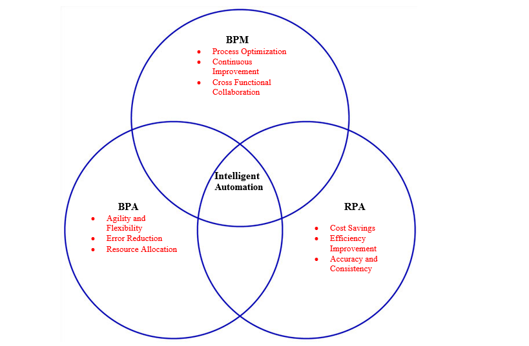
Intersection of BPM, BPA and RPA

Slide 19
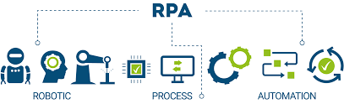
RPA Benefits
Enhanced Efficiency
Automation of Repetitive Tasks
Consistent and Rapid Execution
Improved Performance
Streamlined Processes
Resource Allocation
Handling Monotonous Tasks

Slide 20

RPA Risks
Security Concerns
Data Vulnerability
Bot Access Control
Process Disruption
Error Handling Challenges
Costs and Return on Investment
High Initial Costs
Hidden Costs

